Slide 1
INTRODUCTION TO SOFTWARE ENGINEERING

Slide 2
Legacy SDLCs : Waterfall, V Model, Prototyping, Incremental and Iterative Models

Slide 3
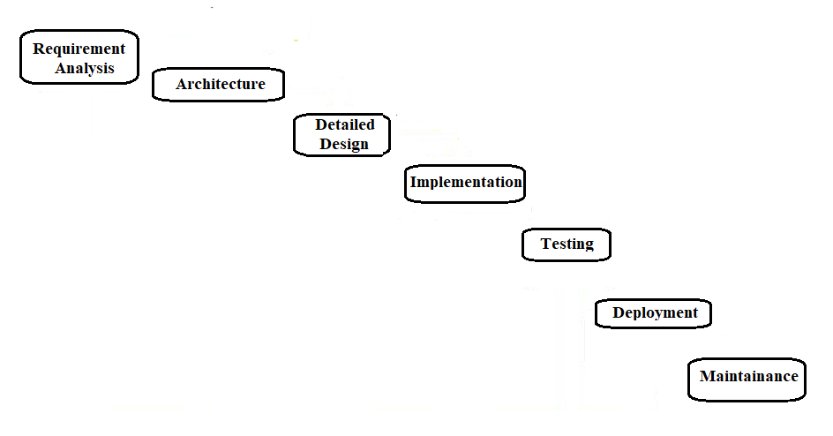
Waterfall Model

Slide 4
Waterfall Model
Advantages
Simple
Clear Identified phases as shown and easy to departmentalize and control
Easy to manage due to the rigidity of the model
Each phase has specific deliverables and a review process
Dis-Advantages
Assumes requirements (both user & hardware) can be frozen
Difficult to accommodate change and hence not very flexible
Sequential. Move from one phase to another only after the completion of the previous phase
Big bang approach .. No working software till late in the lifecycle
High risk and uncertainty
Poor model for long and ongoing projects

Slide 5
Waterfall Model
Usage
Used (in pure form) for short projects where requirements are well understood
Variants are used at a high level in large projects
Product definition is stable and technology understood
Variants used in large globally developed projects with other LC

Slide 6
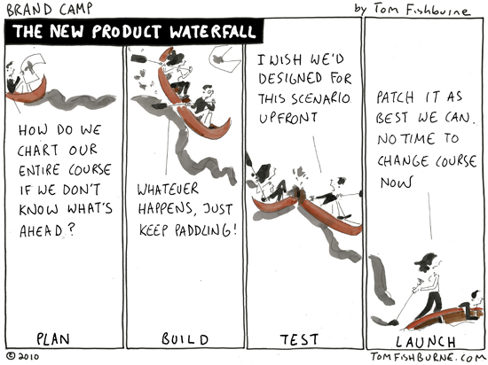
Waterfall Model

Slide 7
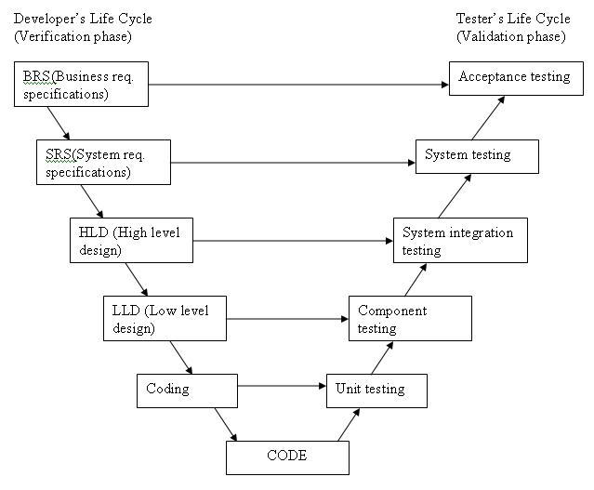
V Model
BRS (Business req specification)
User req

Slide 8
V Model
Advantages
Similar to waterfall model
Test development activities like test design and static testing can happen before coding and the formal testing lifecycle
Higher probability of success
Dis-Advantages
Similar to waterfall model
Software is developed during the implementation phase, so no early prototypes of the software are produced.
Change through the process, necessitates changes in test documentation too.
Usage
Similar to waterfall model

Slide 9
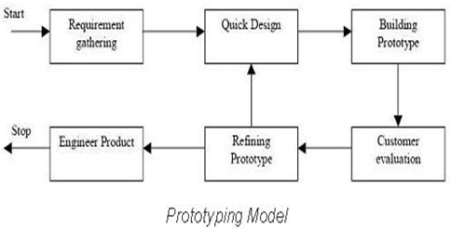
Prototyping
Prototyping should be a relatively a cheap process (subset, non production quality etc.)
Instead of freezing the requirements before a design or coding can proceed, a complete system prototype (with no or very less details) is built and to understand the requirements
Throw-away and evolutionary prototypes

Slide 10
Prototyping
Advantages :
Active involvement of the users
Provides better risk mitigation (cost, understanding of the user requirements)
Problems/defects are detected earlier and hence reduces time and cost
Missing functionality easily identified and hence resulting system is full featured
Systems are mostly more stable
Dis-Advantages:
Practically, this methodology may increase the complexity of the system as scope of the system may expand beyond original plans
Performance of the resulting system may not be optimal

Slide 11
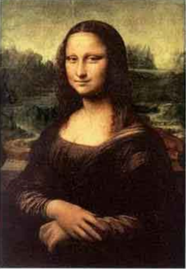

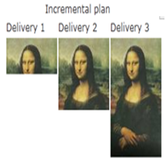


Incremental Model
In this model requirements are partitioned and an incremental plan is made for delivery
Working version of software is produced during the first module, so we have a working software early on in the software life cycle.
Each subsequent release of the module adds functionality to the previous release.
This continuous integration continues till the complete system is achieved.

Slide 12
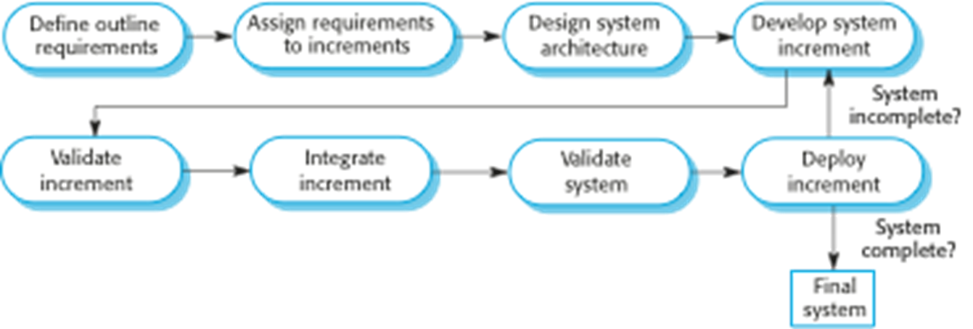
Incremental Model
The partitioned requirements can each have a development lifecycle
Models like waterfall could be used/employed for each of the partition/increment
Leveraged prototype for additional features would be a form of incremental model

Slide 13
Incremental Model
Advantages :
Customer value – as early versions can be delivered to customers
More flexible – less costly to change scope and requirements as, early increments act like prototypes
Easier to test and debug during a smaller iteration.
Easier to manage risk .. risky pieces are identified and handled during iteration ..customer can respond to it .. no big bang
Continuous increments rather than monolithic
Reduces over-functionality. Essential features first and additional when needed
Dis-Advantages:
Needs good planning and design
Needs clear and complete definition of the whole system before it can be broken down and built incrementally
Total cost is higher than waterfall.
Hard to identify common facilities that are needed by all increments
Management visibility is reduced which could lead to surprises

Slide 14
Incremental Model
Usage :
In projects where major requirements are defined (although some details can evolve with time)
When there is a need to get a product to the market early.
When a new technology is being used
Resources with needed skill set are not available
There are some high risk features and goals.

Slide 15
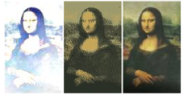
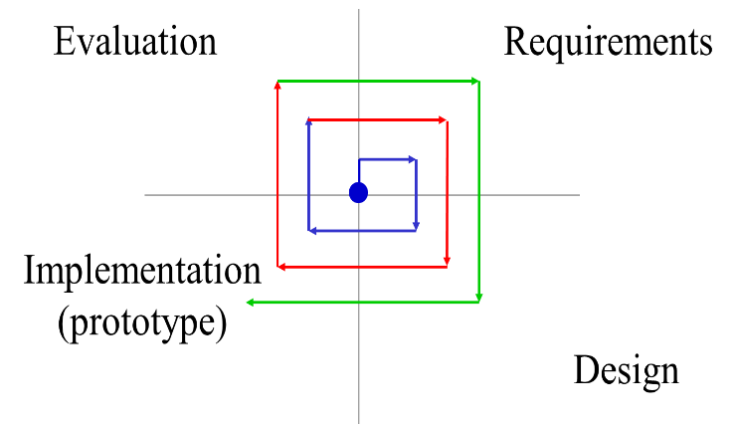
Iterative Model (Evolutionary)
Initial implementation attempts to start with a skeleton of the product, followed by refinement through user feedback and evolution until system is complete.
Built with dummy modules
Rapid prototyping
Successive refinement
Advantages
Helps in identifying requirements, visualization of solution
Supports risk mitigation
Redesigning/Rework and defect flowing down the process is reduced
Incremental investment

Slide 16
Iterative Model (Evolutionary)
Disadvantages
Each phase of an iteration is rigid with overlaps
Costly system architecture or design issues may arise because not all requirements are gathered up front for the entire lifecycle
Usage:
Large projects

Slide 17
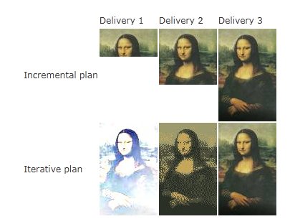
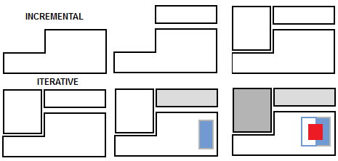
Contrasting Incremental and Iterative Models
Incremental approach does not require going back and changing things that are already delivered whereas Iterative continues to revisit and refining everything every time
Incremental focuses on things not implemented, whereas Iterative is more details of the same
Incremental does not leverage on the experience/knowledge till then, whereas iterative leverages learning's.

